Slide 1

Enhancing Northeastern’s Workday Portal with Email Notifications

Slide 2
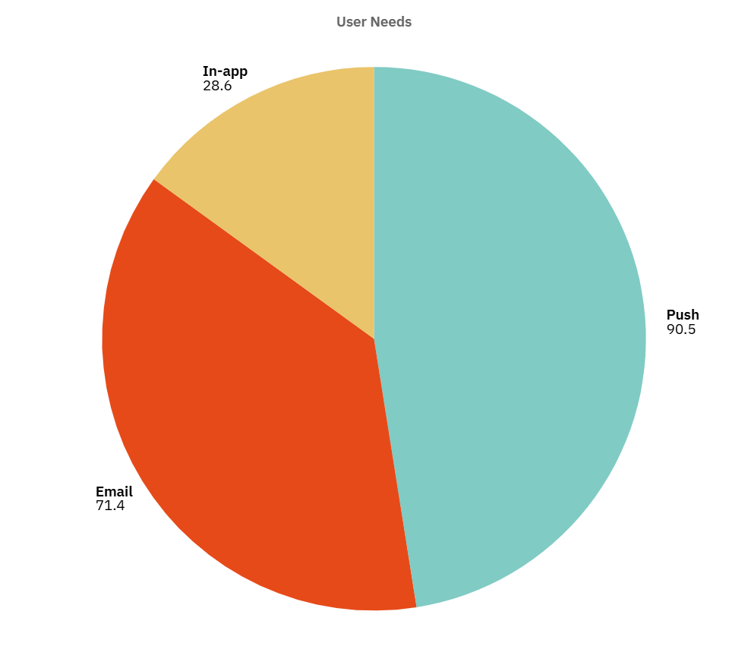

Why Email Notifications Matter?
Northeastern’s Workday portal is critical for international students seeking on-campus jobs.
73% of 63 surveyed students miss job opportunities due to no notifications.
Solution: Enable Workday’s Job Alerts for daily email notifications.
Impact: Save 10–20 min weekly, boost applications by 30%, enhance satisfaction (3.1/5 to 4/5).

Slide 3
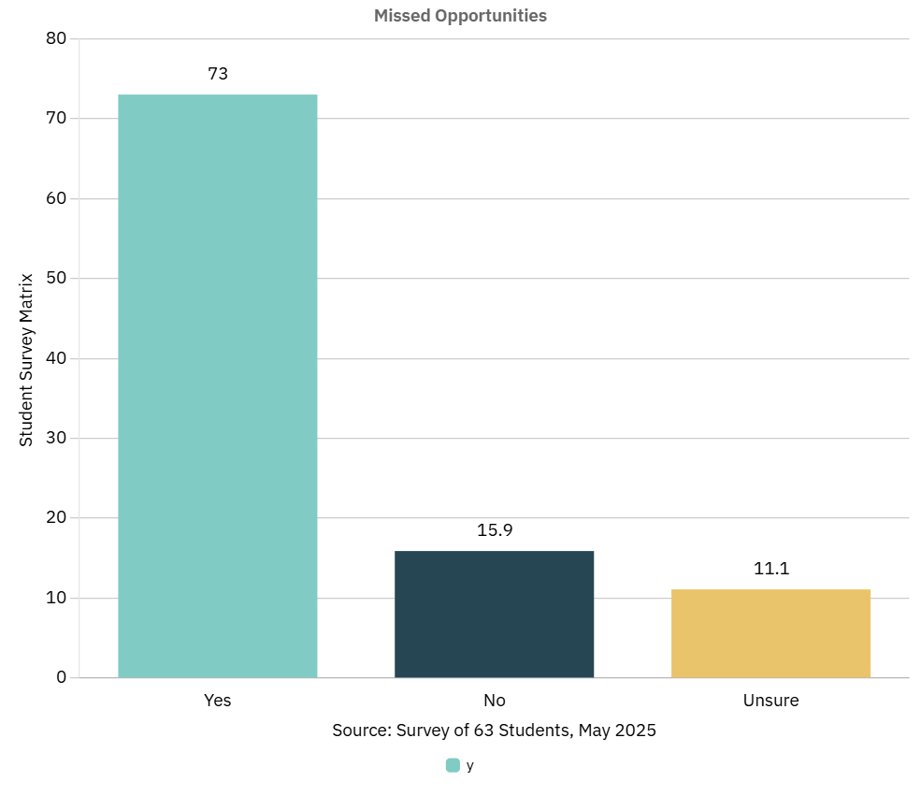
The Challenge with Northeastern’s Workday
Northeastern University’s Workday job portal lacks notifications, causing students to miss on-campus job opportunities. This proposal offers a simple email notification feature to alert students of new postings. A prototype (https://husky-hub-alert-emails.lovable.app/) demonstrates the solution, enhancing job access for students.

Slide 4
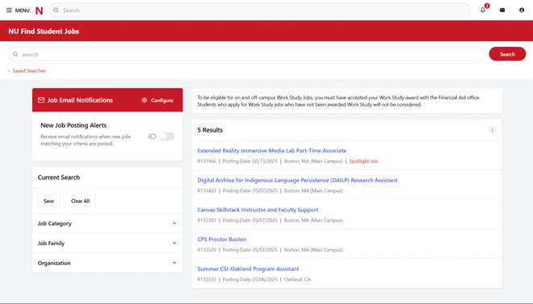
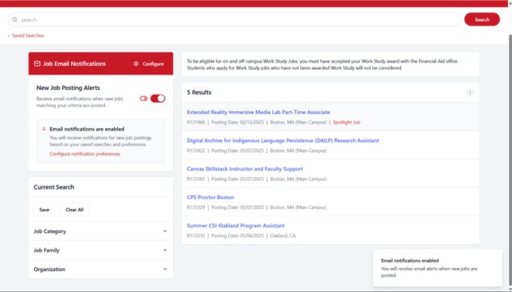
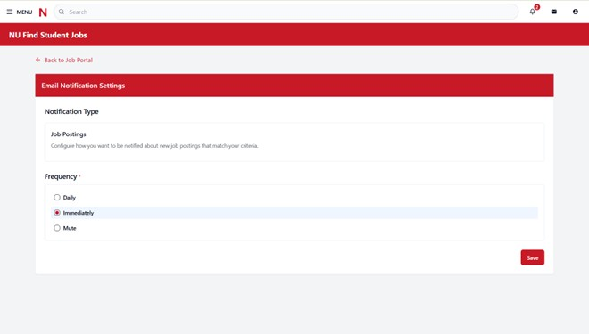
Workday Job Alerts Implementation
An email notification system integrated into Northeastern University’s Workday job portal alerts all students seeking on-campus jobs about new postings, ensuring timely awareness to support financial stability and career growth while enabling recruiters to fill roles efficiently. By sending reliable email alerts with clear job details and application links, the system eliminates constant manual checks, and customizable preferences allow students to tailor alerts to their academic schedules, simplifying applications.

Slide 5
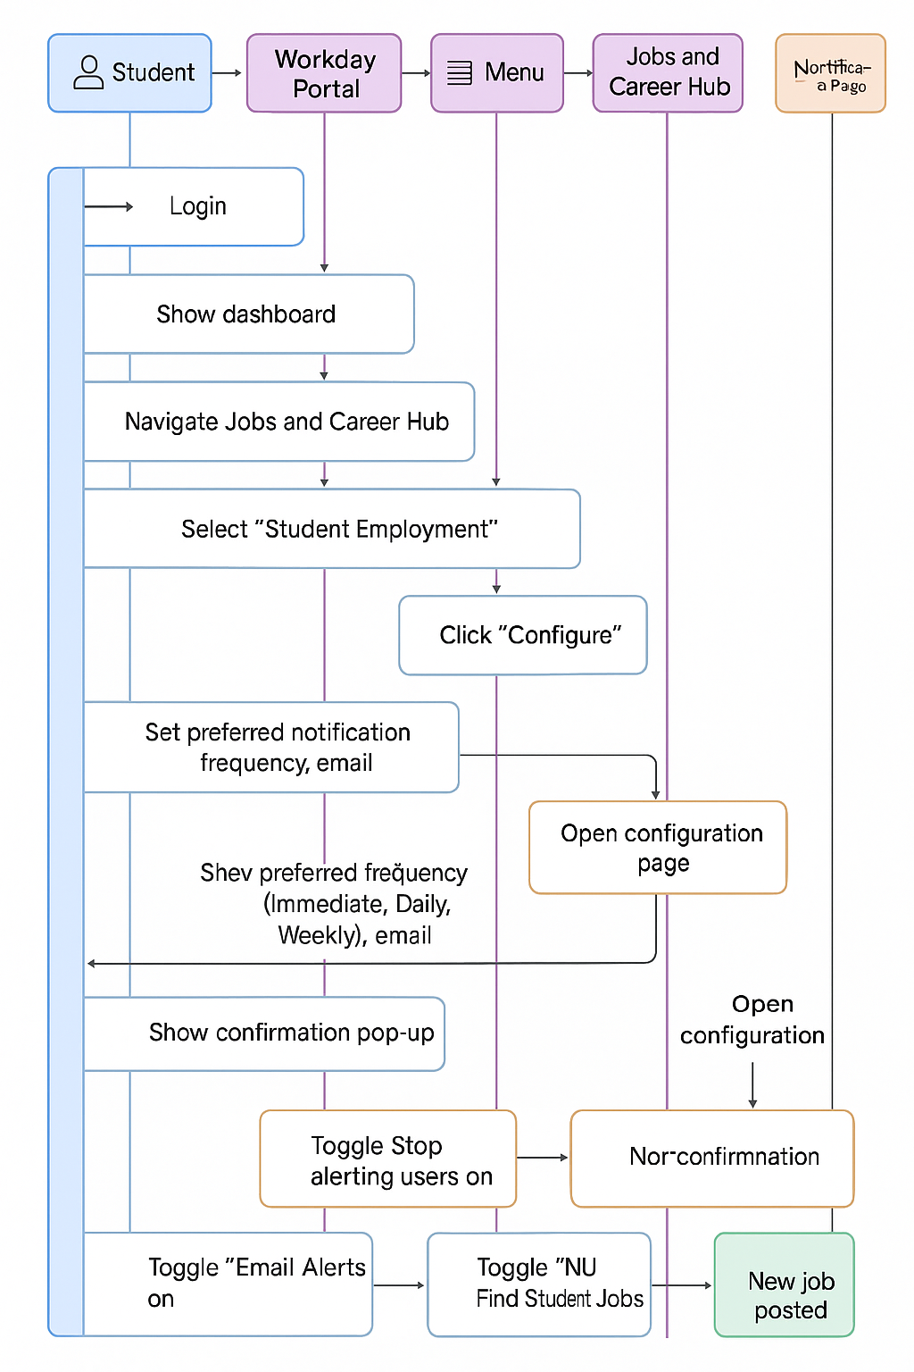
A Seamless Student Experience
Scenario: International student logs into Workday.
Pop-up: “Enable daily email alerts” (one-click toggle).
Next day: Email alert for IT support job in Boston.
Outcome: Applies in <24 hours, saves 10–20 min weekly.

Slide 6
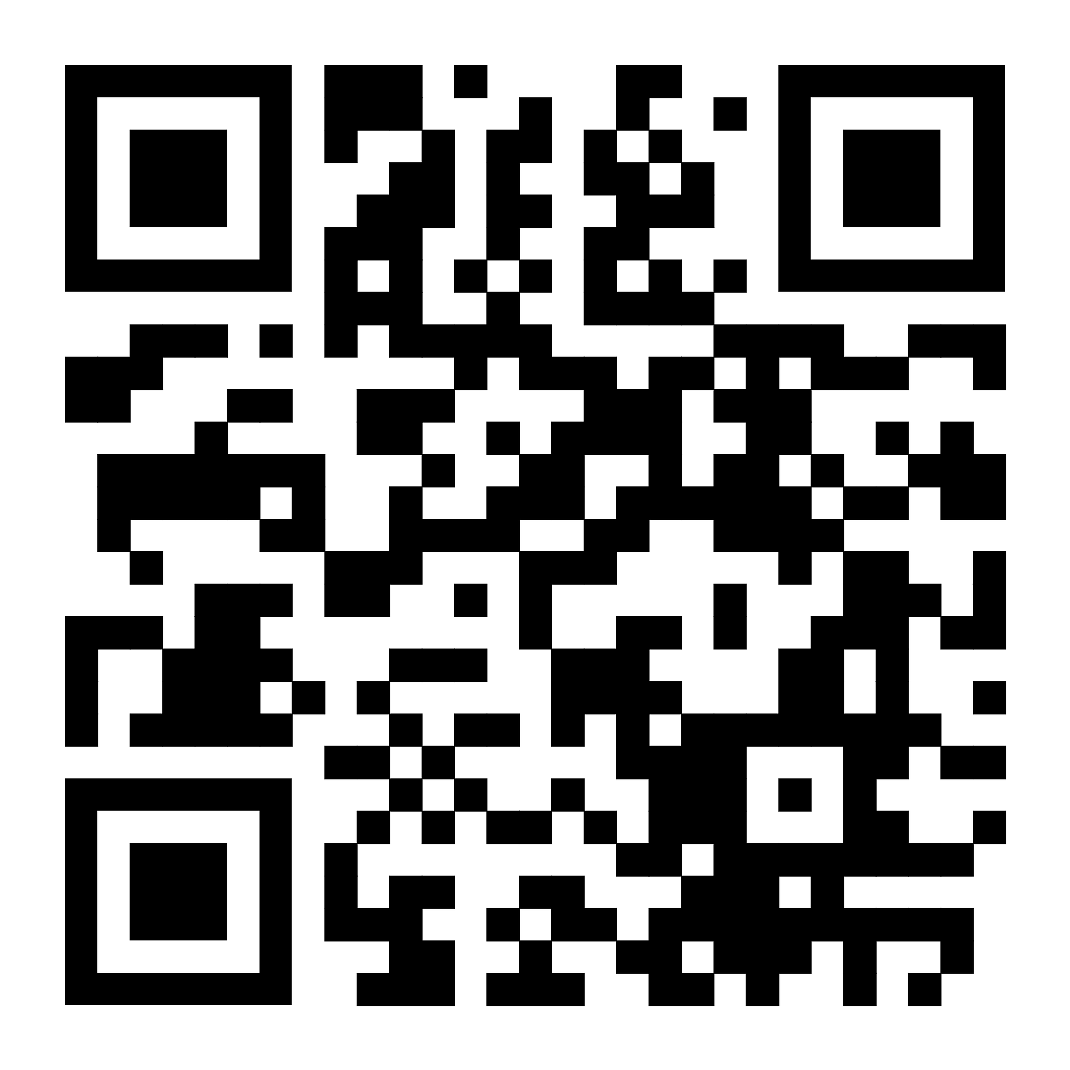
See It in Action See It in Action
Interactive prototype showcases:
“Subscribe to Job Emails” toggle.
Pop-up prompt for quick setup.
Clean, user-friendly design.
Link: https://husky-hub-alert-emails.lovable.app/

Slide 7
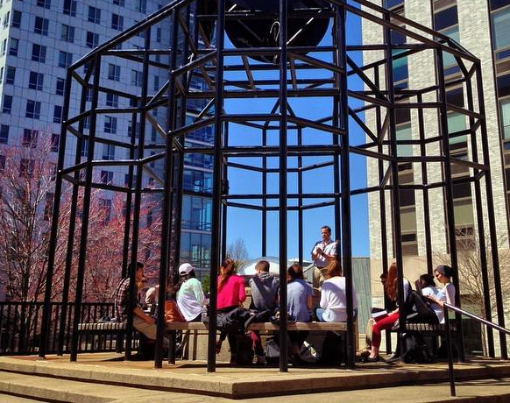
Benefits
Students: Save 10–20 min/week, 30% more applications, tailored alerts.
Recruiters: Faster role filling, reduced vacancies.
Northeastern: Satisfaction up to 4/5, supports 88.9% international students.
Scalability: Serves 20,000+ students across 14 campuses.

Slide 8
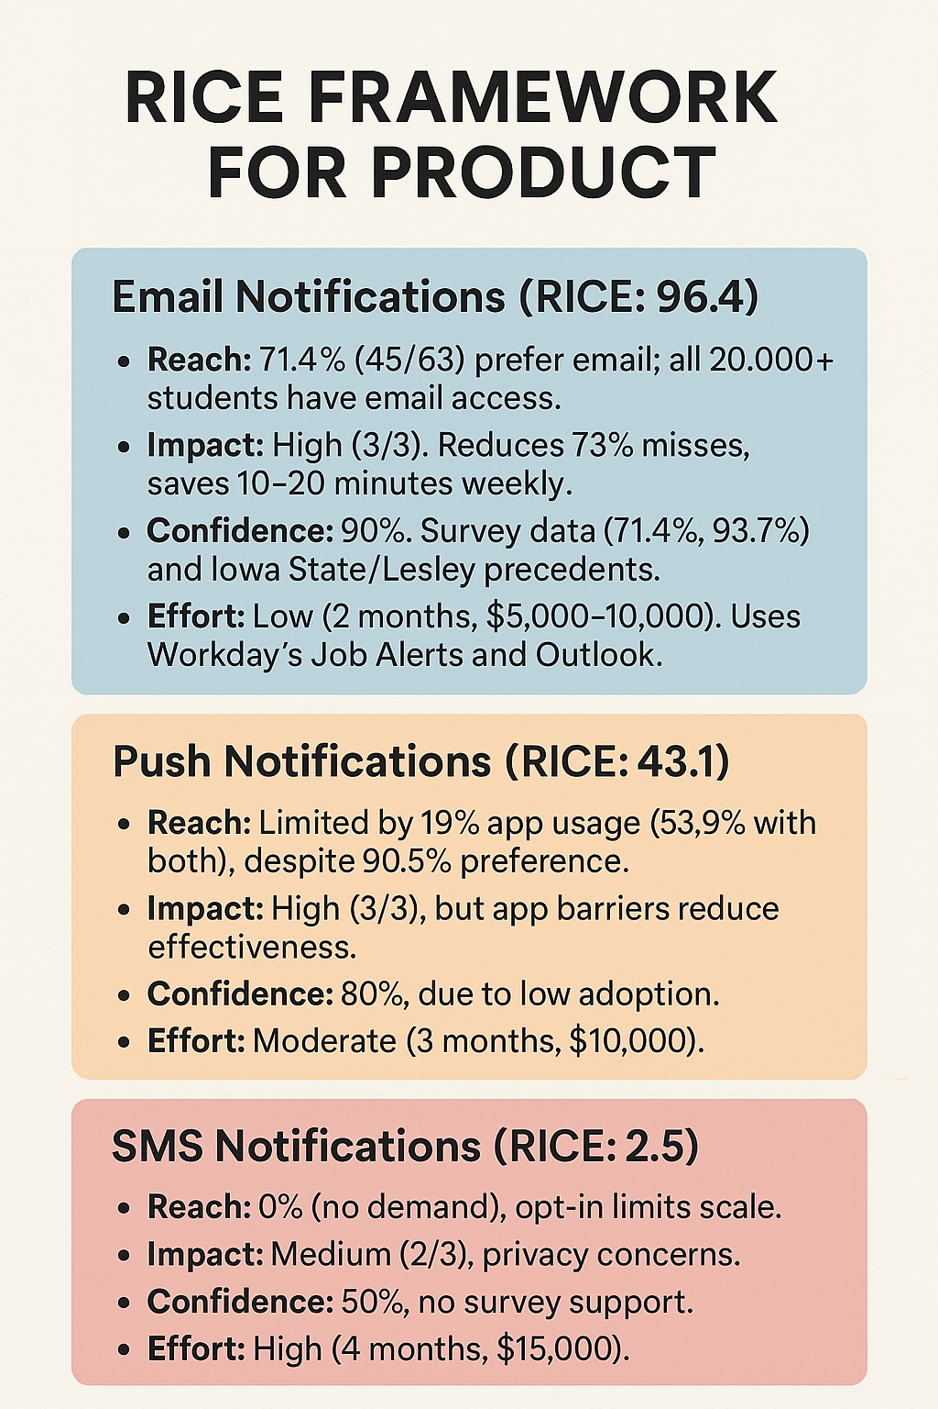
Why Email?
RICE Score (Email Notifications): 96.4
Reach: 71.4% prefer email, 20,000+ students accessible.
Impact: Reduces 73% misses, saves time.
Confidence: 90% (survey + Iowa State/Lesley precedents).
Effort: 2 months, $5,000–10,000 (Workday + Outlook).
Precedents: Iowa State, Lesley, Washington and Lee use Workday Job Alerts.
Cost: $500/month maintenance.

Slide 9
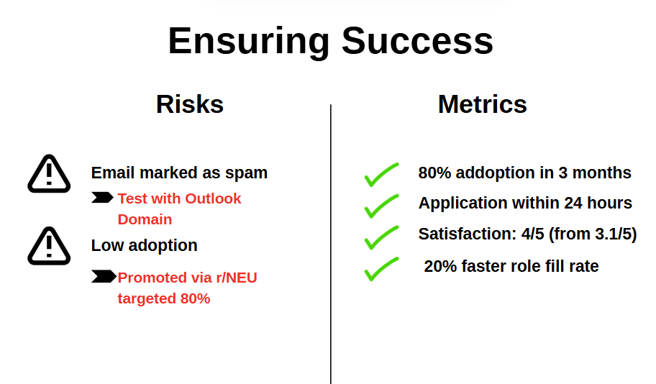
Ensuring Success
Risks:
Emails marked as spam (Mitigation: Test with Outlook domain).
Low adoption (Mitigation: Promote via r/NEU, target 80%).
Metrics:
80% adoption in 3 months.
Applications within 24 hours.
Satisfaction: 4/5 (from 3.1/5).
20% faster role fill rate.

Slide 10

Let’s Transform Workday
Approve Phase 1 for email notifications (4 months, $5,000–10,000).
Support 38% international students and 20,000+ users.
Next Steps: Meet with IT Services and Student Employment to align.

Slide 11

Supporting Evidence
Iastate.edu. (2019). Job alerts now available in Workday. [https://www.inside.iastate.edu/index.php/article/2019/09/26/jobalerts]
Support Hub. (2024). Creating a Job Alert in Workday. [https://support.lesley.edu/support/solutions/articles/4000196470-creating-a-job-alert-in-workday]
Wlu.edu. (2025). Workday Application Instructions. [https://www.wlu.edu/employment-opportunities/staff-positions/application-instructions-for-new-external-applicants]
UNLV Workday Email Notifications. [https://www.unlv.edu/sites/default/files/page_files/27/Workday-Email-Notifications.pdf]

Slide 12
Thank You!

